Slide 1




25 years of WorldFengur

Slide 2
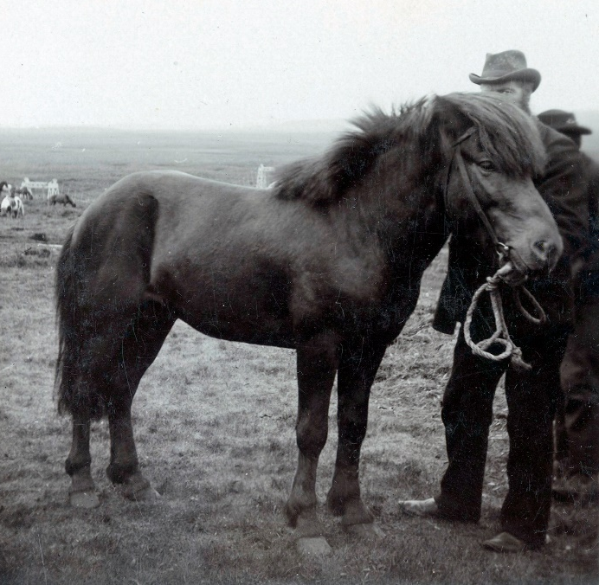
The studbook for the Icelandic horse
Began in 1923 – not all horses registered
a selective studbook with minimum scoring requirements
a studbook number
In 1987: horses registered with the unique life number:
1987125132
In 1989 decided to register all horses in Iceland, regardless of their breeding assessment results
Led to the development of a digital database called Fengur (1991)

Slide 3
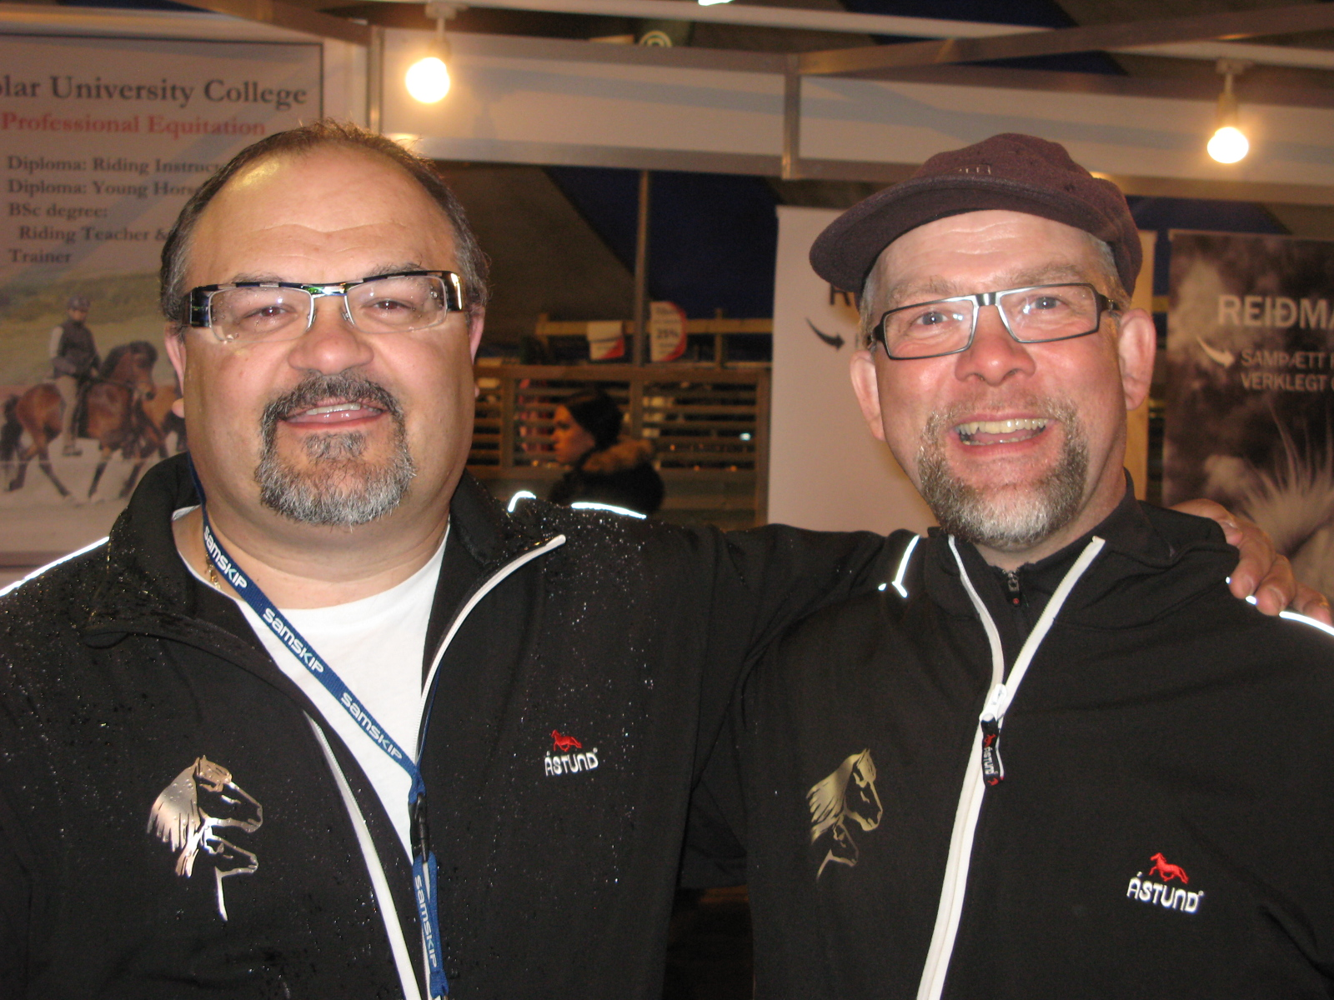
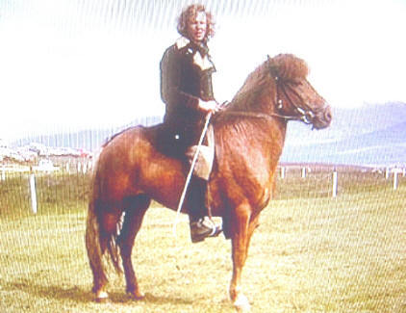
Precursors to WorldFengur
Fengur was the precursor to WorldFengur
Used for Studbook work in Iceland
Formed the basis with data of 9.000 horses
Soon PC-Fengur (1994) available on floppy disk
Followed by Íslandsfengur (1997) on CD-ROM
VeraldarFengur (1998)
- the first internet-based version of the database
Jón Baldur Lorange and Kristinn Hugason
- the main persons in this valuable development
Þorvaldur Árnason – a key person in the development of the database

Slide 4
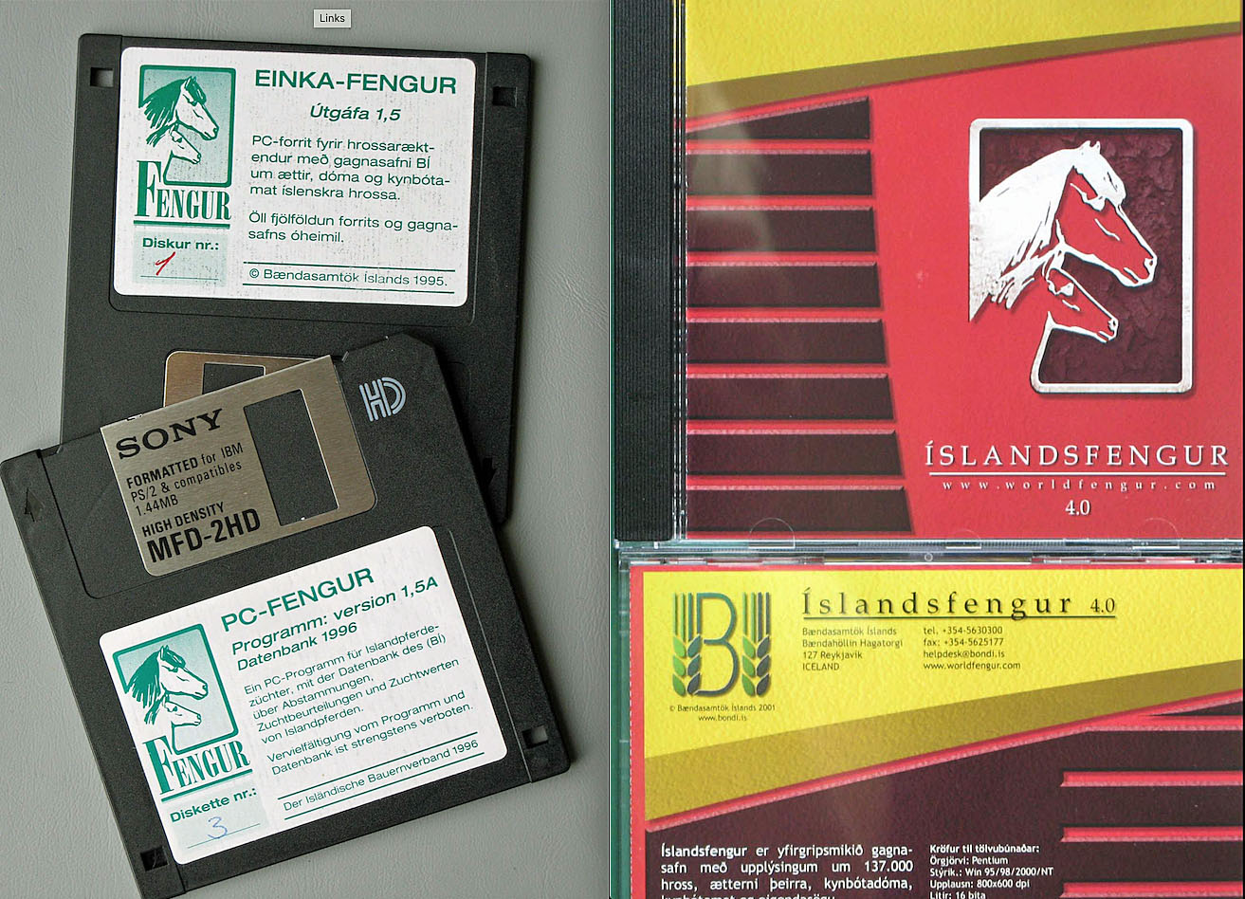

Slide 5
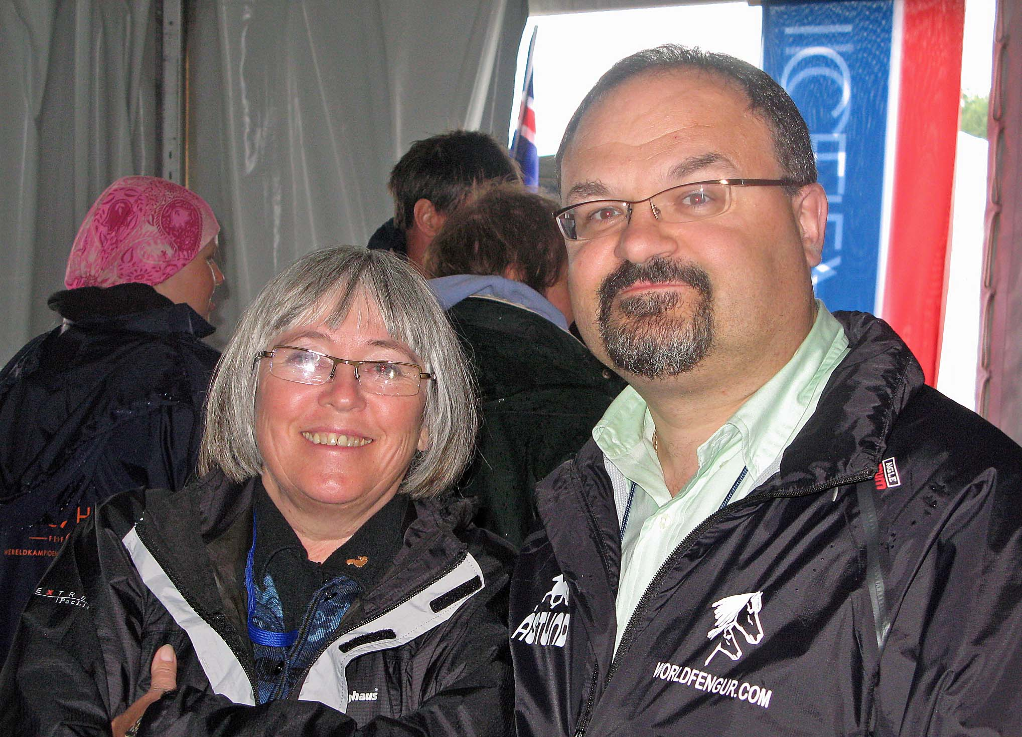
WorldFengur – global database for the Icelandic horse
In 2000 co-operation agreement between
FEIF and Farmers Association in Iceland and was signed
Objectives of the WorldFengur project
To register the whole population of Icelandic horses in one database
To calculate BLUP breeding value scores for all Icelandic horses in the world
Offer member associations of FEIF a common online studbook for their daily administration
In 2001, WorldFengur was opened for public use at the World Championships in Austria by Jens Otto Veje

Slide 6
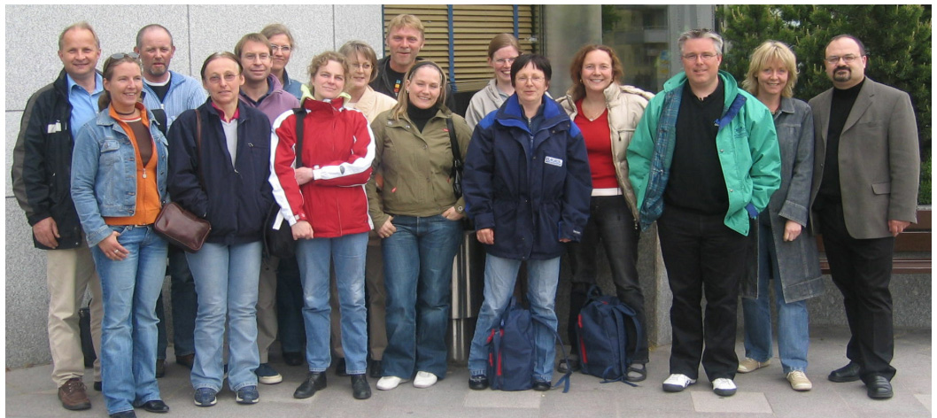
Ever growing database
In year 2011 – 9.507 subscribers
In year 2018 – 18.168 subscribers
Today: over 28.000 subscribers – 1.340.000 visits last year!!
In the beginning: 9.000 horses were registered
Now we have 585.476 horses registered
Alive: 311.542 horses in all the FEIF countries
Tremendous work has been done through the years by the WF registrars!!

Slide 7
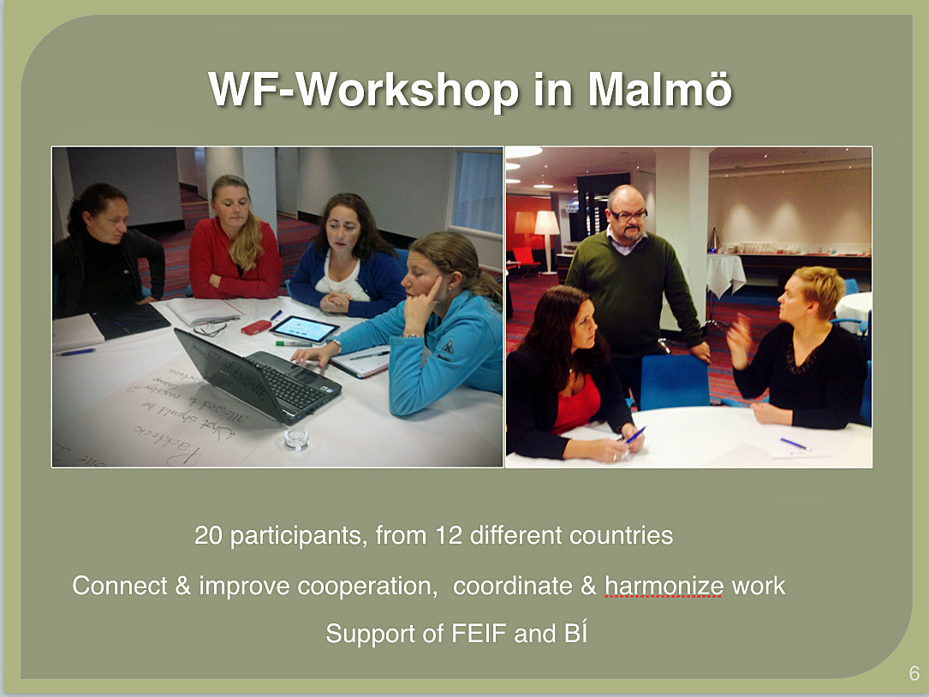
FEIF Registration Group
To support and standardise registration work done in WorldFengur
The first chairman Clive Philips from Scotland
Since then
Kati Ahola (Finland)
Inge Kringeland (Norway)
Mike Edwards (Great Britain)
Kristín Halldórsdóttir (Germany)
Members of the group through the years
Þorberg Þorbergsson – main programmer
Kim Middel (Netherlands)
Hallveig Fróðadóttir (Iceland)
Annette Knutsen (Denmark)
And of course, Jón Baldur Lorange

Slide 8
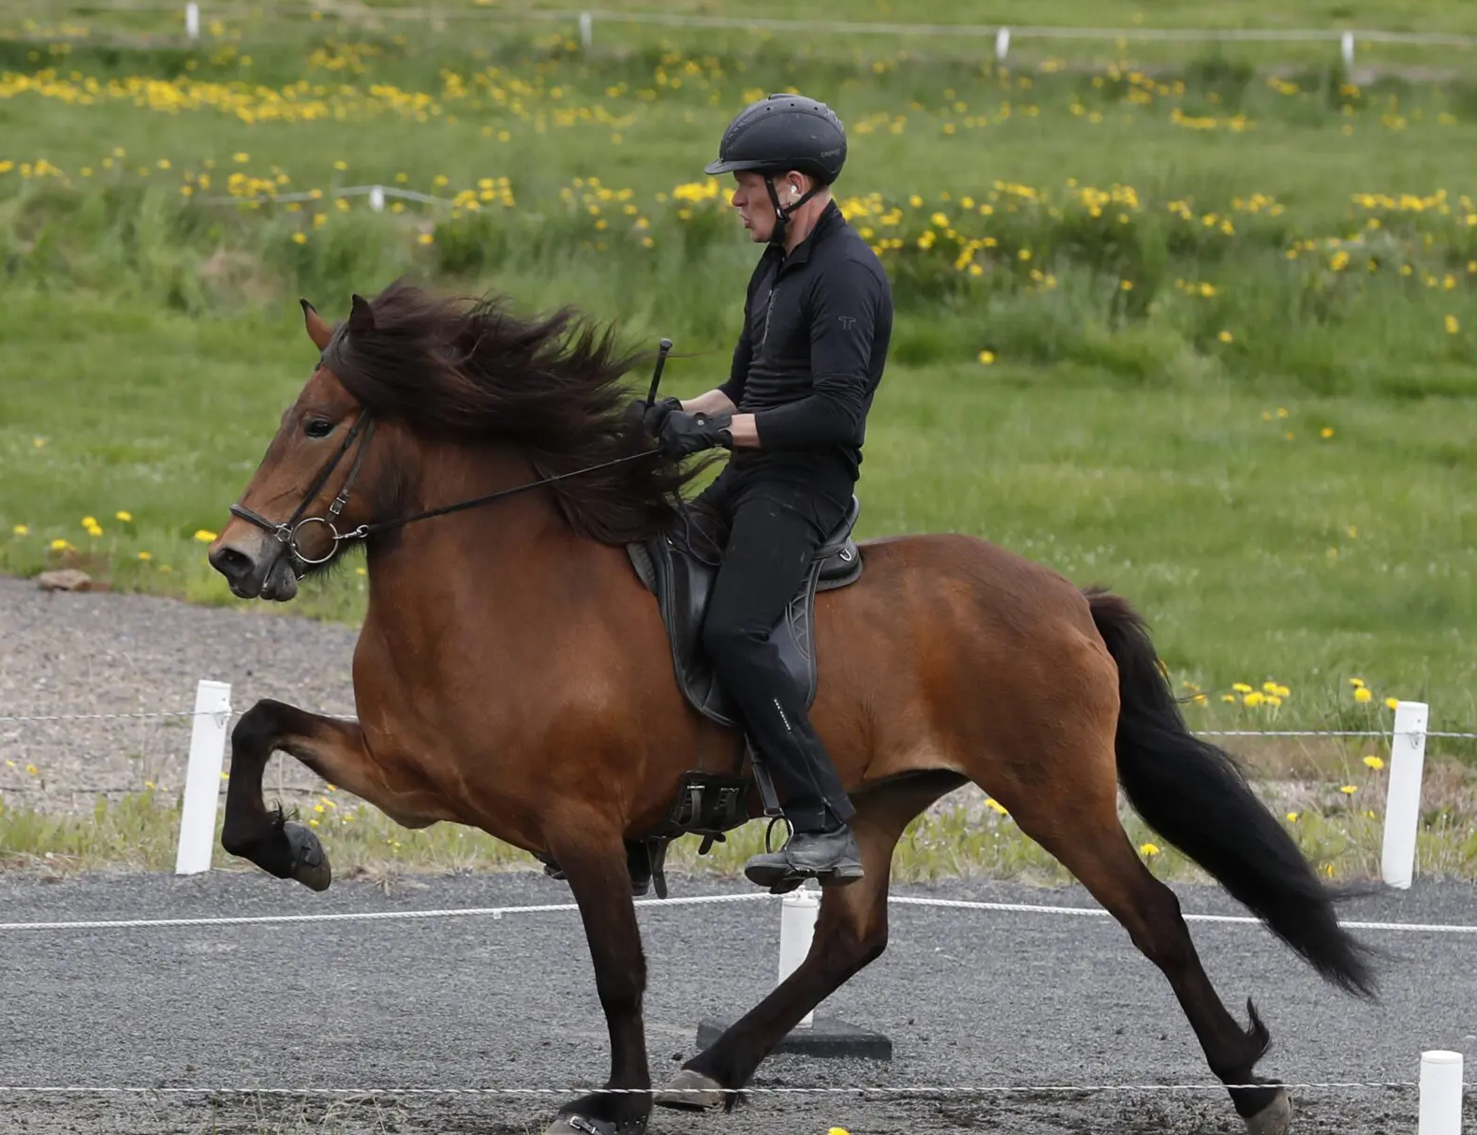
International BLUP values
In the year 2005 one of the initial and most important goals of the WorldFengur project was achieved
The calculation of international BLUP breeding values
In the beginning for 190.000 horses from 11 different countries
Today the BLUP evaluations included BLUP values for over 500.000 horses from all over the world
Based on 38.000 results from breeding shows and 172.000 competition records

Slide 9
Valuable data
The data entered in WorldFengur consists of
Basic information - name, color and pedigree which is traceable all the way back to ancestors born in Iceland
Information on breeders, owners, offspring, breeding evaluations, photos, videos, horse names, horse colors and results from sports competitions and breeding assessments
The backbone of the database is the unique identification number (FEIF ID-number) together with UELN number of each horse

Slide 10
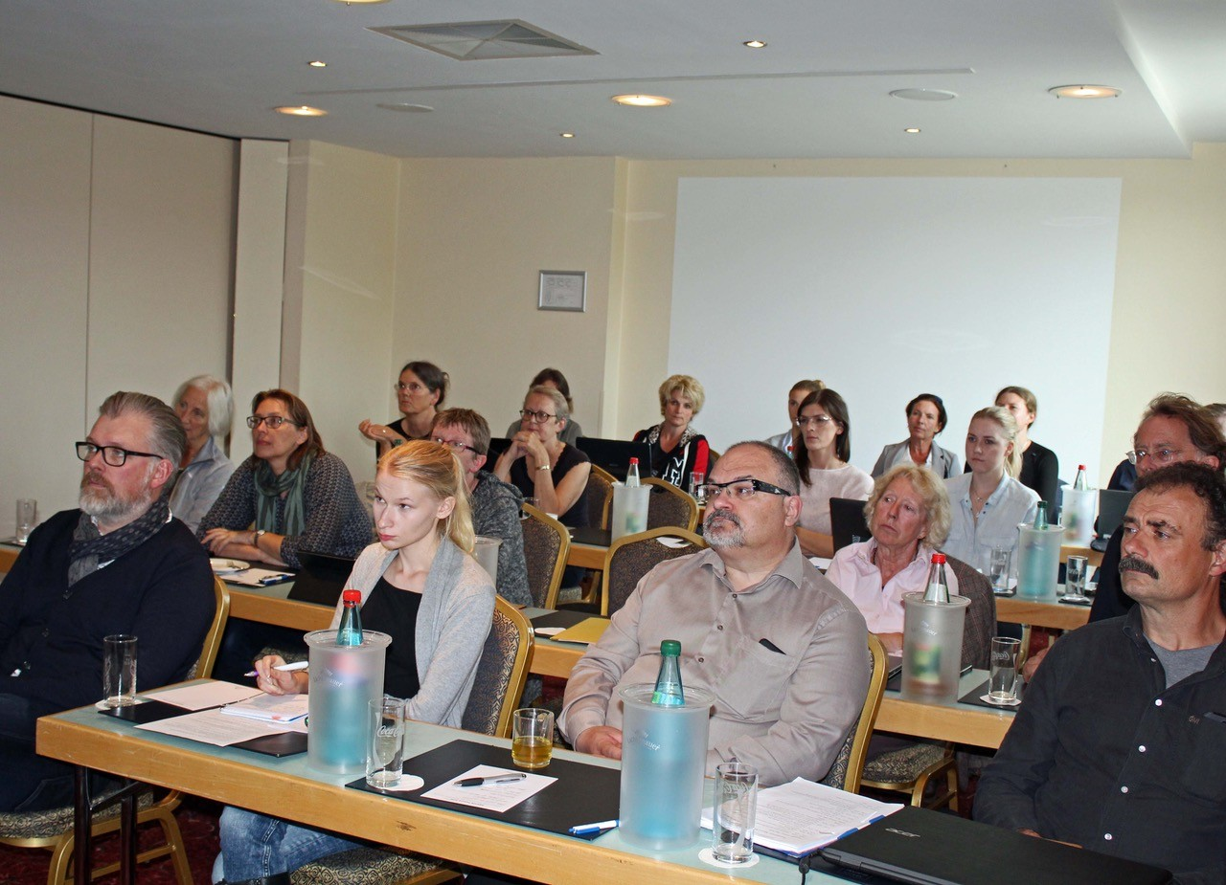
The registrars
More than 100 registrars in 23 countries are responsible for registering the horses into WorldFengur
Most FEIF member association gets free access to WorldFengur for all its individual members, a total of approximately 43.000 people
WorldFengur is available in 10 languages
Ever growing name bank with 14.500 names…

Slide 11
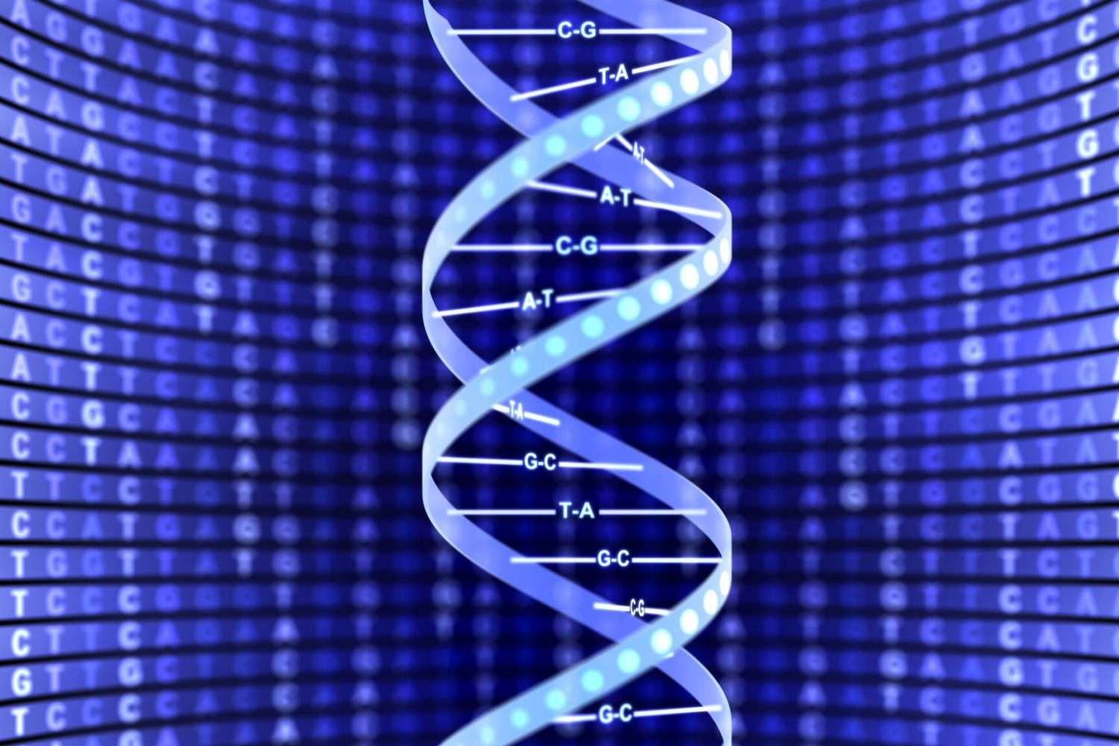
DNA
WorldFengur contains a data-sharing DNA database
DNA profiles from laboratories all over the world are stored
A cooperation between DNA laboratories was established to make this possible
Enables the proof of parentage of horses located in different countries
A program is in WorldFengur automatically checks ancestries
Results are published immediately

Slide 12
Virtual mating and stallion selection
The “virtual mating” feature
Important tool for breeders in the selection of stallions for their broodmares
Based on traits included in the breeding goal of the Icelandic horse
For the potential foal:
Breeding values for all traits
Inbreeding coefficient
Possibility of colors
This way, breeders can see which traits a certain stallion is expected to improve

Slide 13
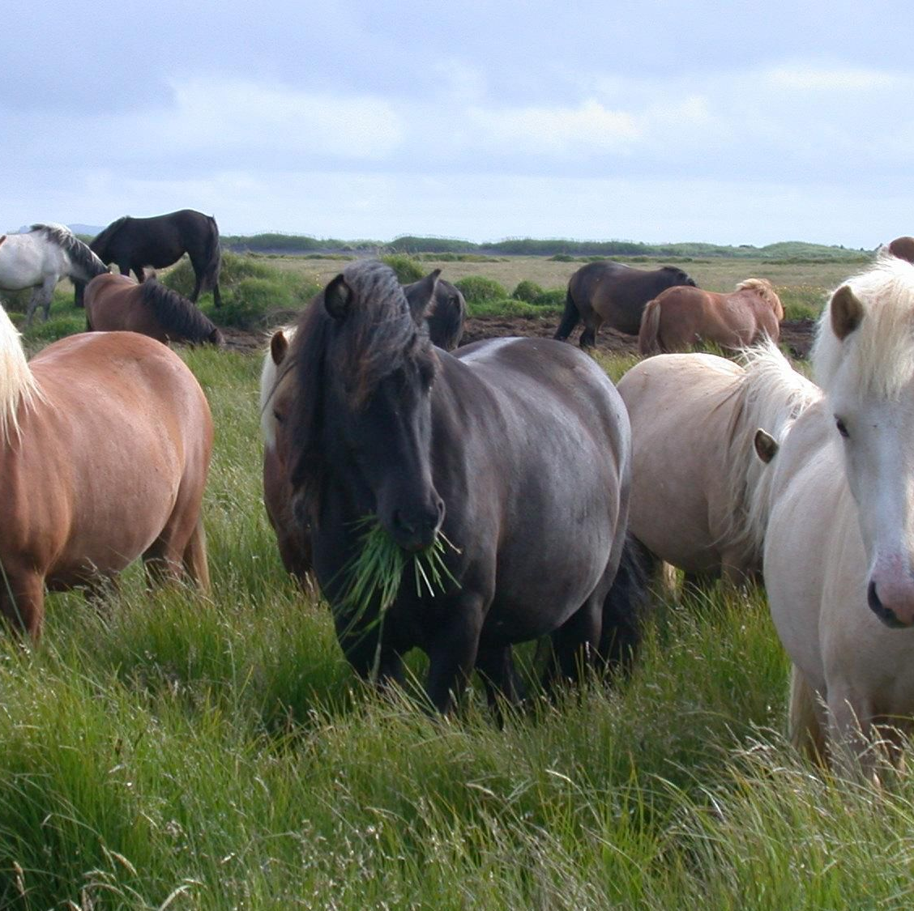
Colors of the Icelandic horse
In WorldFengur users can look up useful information on horse colours
Hundreds of example photos and genetic information on horse color inheritance

Slide 14
Next steps into the future
Reprogramming of WorldFengur
Securing the data
Updating of software
Increased features
New platforms - Easy access
Make WorldFengur an even better breeding tool
New challenges, such as changing national and international regulations
A WF survey in the autumn 2025 with close to 900 responses from 23 countries!
The key to it all will always be threefold: to serve breeders, breeding associations and Icelandic horse enthusiasts in general

